Slide 1








Air Quality Index (AQI) Prediction Using Machine Learning
A data-driven project focusing on analyzing air pollution data and predicting AQI using ML model
Presented By:
Mahmuda Sultana
ID:231-115-018

Slide 2

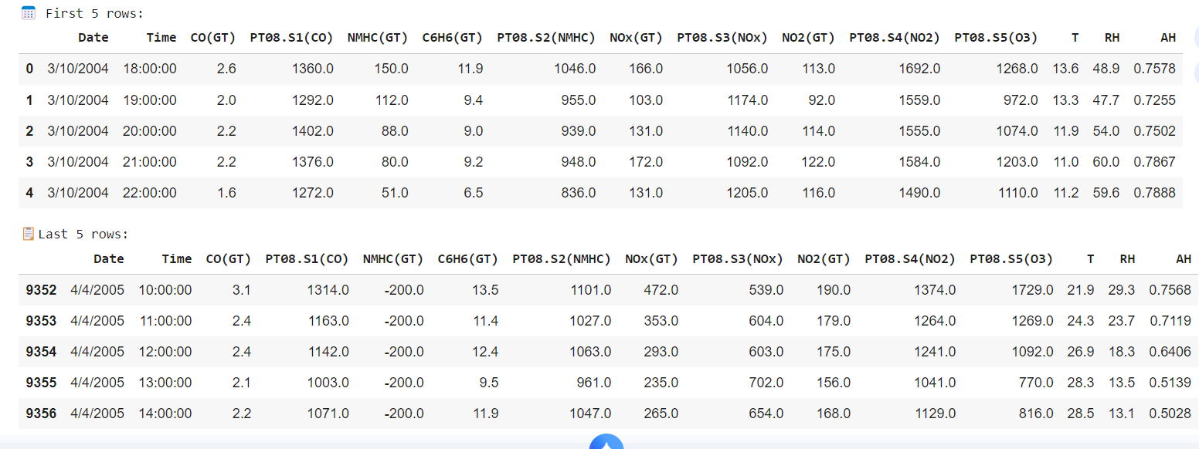
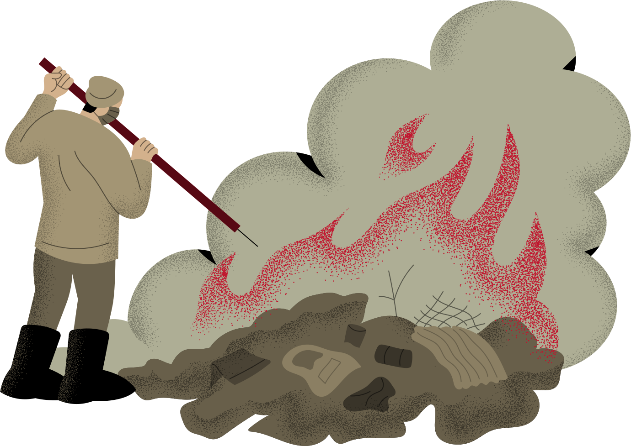
Dataset Information
• Provide an overview of the AirQualityUCI dataset
• Loaded dataset from Google Drive
• Removed unnecessary columns and adjusted dataset size

Slide 3


Initial Data Inspection
Objective:
Inspect overall dataset quality before deep analysis.
Detect basic issues like missing values, incorrect formats, unwanted columns.
What We Worked On:
Printed summary statistics & column information.
Identified missing values and data types.
Viewed dataset's first 5 rows to understand structure.
Prepared the dataset for advanced cleaning.

Slide 4
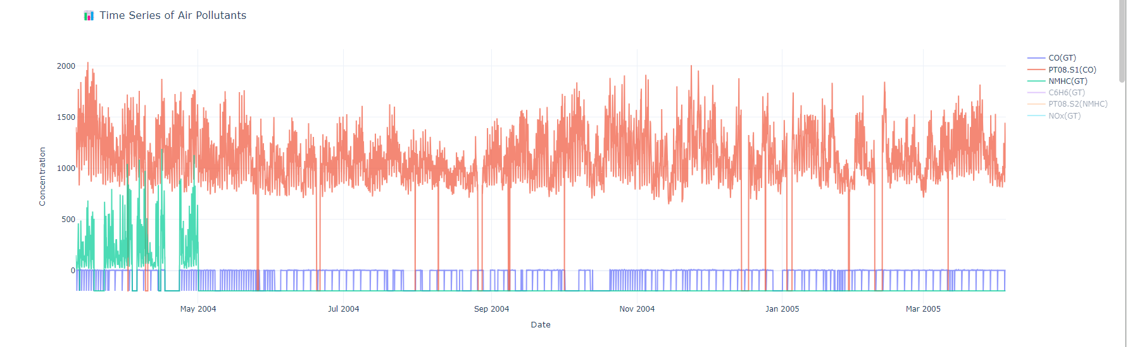

Time Series of Air Pollutants
Objective:
What We Worked On:
Visualize how pollutant levels change over time.
Identify trends, spikes, patterns, or seasonal variations
Created a DateTime index combining Date + Time.
Extracted temporal features (Year, Month, Day, Hour).
Built interactive Plotly time-series graphs for pollutants.
Helped understand pollution patterns hourly, daily, and seasonally.

Slide 5


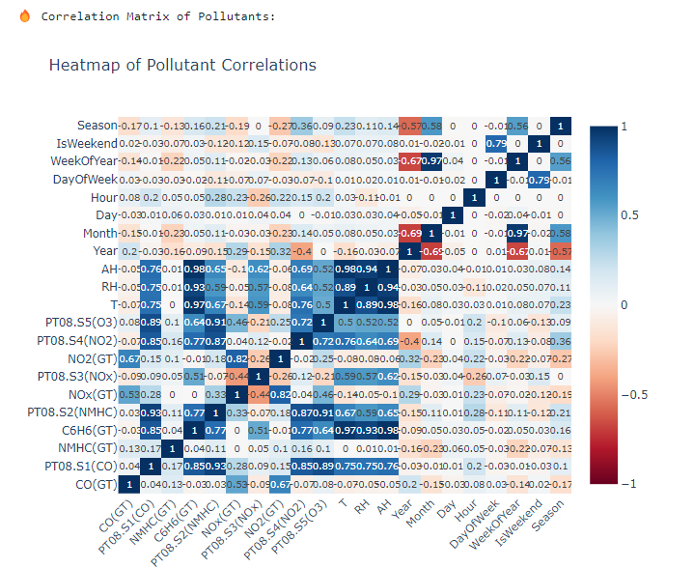
Heatmap of Pollutant Correlations
Objective:
Identify relationships between pollutants.
Detect groups of pollutants that move together (positive correlation) or opposite (negative correlation).
What We Worked On:
Computed pollutant correlation matrix.
Visualized it using an interactive Plotly heatmap.
Highlighted strong correlations between gases like CO, NO₂, and benzene.
Used insights to improve feature selection & modelling.

Slide 6
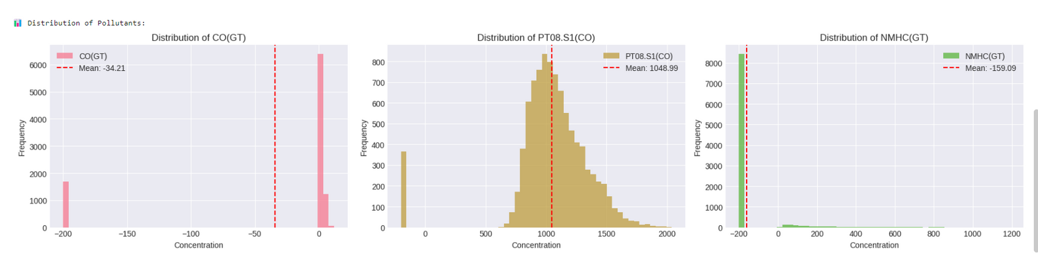
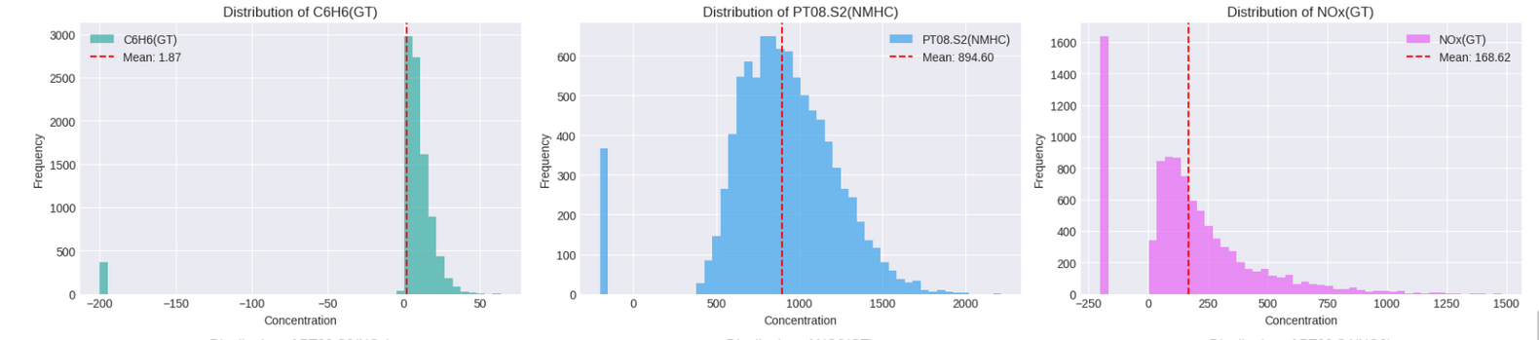
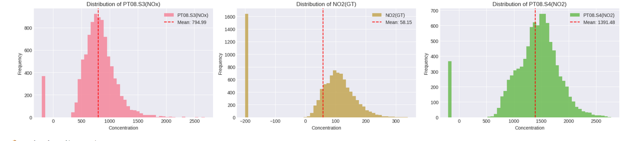
Distribution of Pollutants
Objective:
Understand the distribution (normal, skewed, multi-modal) of each pollutant.
Detect irregularities or extreme values.
What We Worked On:
Plotted histograms for first 9 pollutants.
Added mean indicators to understand central tendency.
Observed skewness and variability.
Guided decisions for scaling and cleaning.

Slide 7
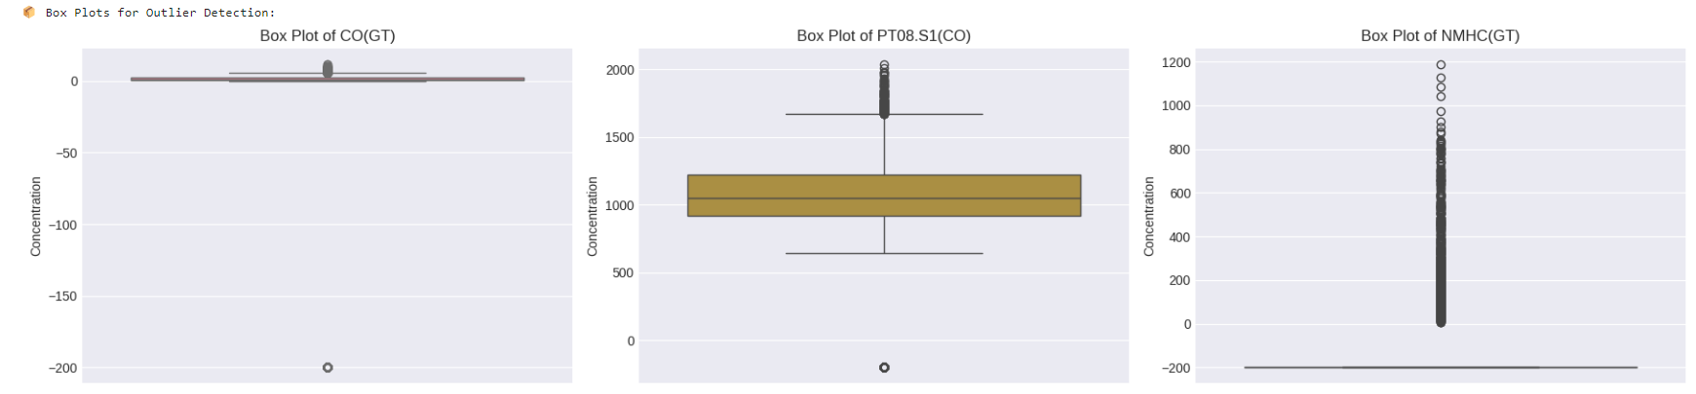
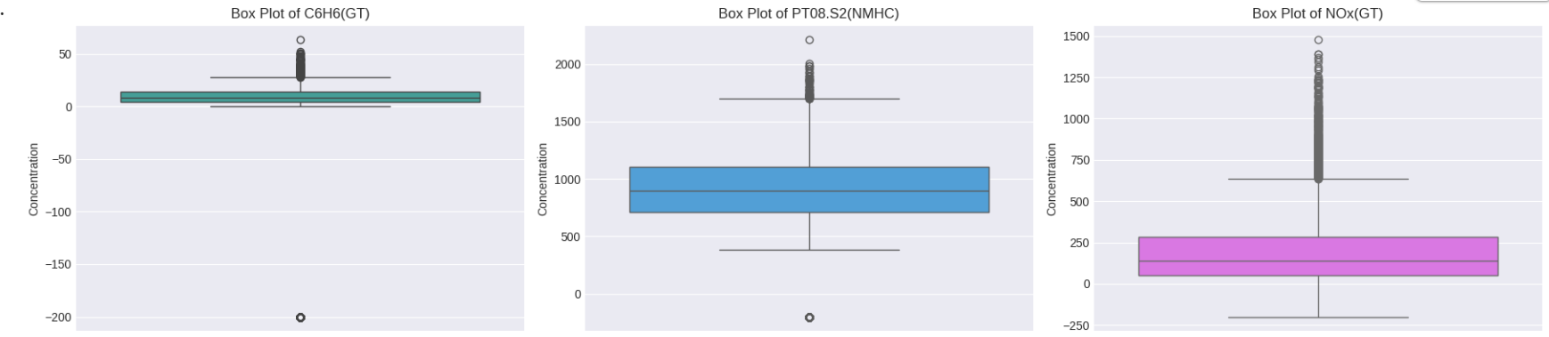
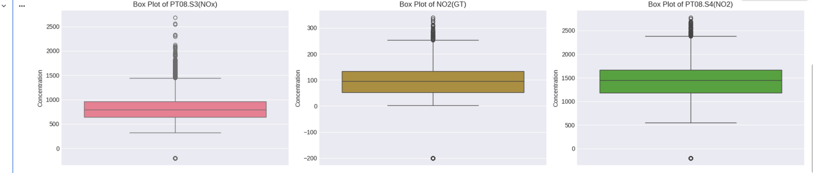
Box Plots for Outlier Detection
Objective:
Detect extreme pollutant values that may distort modelling.
Visualize distribution spread and IQR boundaries.
What We Worked On:
Created box plots for pollutants.
Identified outliers in CO(GT), NOx(GT), etc.
Used findings to apply IQR–based outlier handling in the cleaning stage.

Slide 8
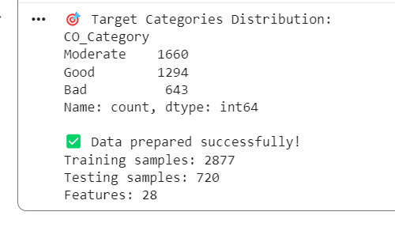
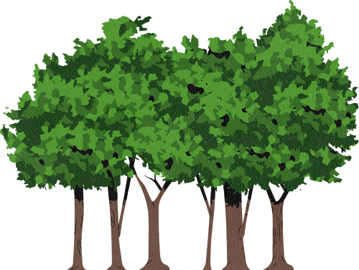

DATA PREPROCESSING
Objective:
Define regression and classification targets.
Convert CO levels into air-quality categories.
Prepare, split, and scale data for modeling.
What We Worked On:
Created CO categories (Good, Moderate, Bad).
Selected features and split data into train/test sets.
Scaled all features for regression and classification tasks.

Slide 9
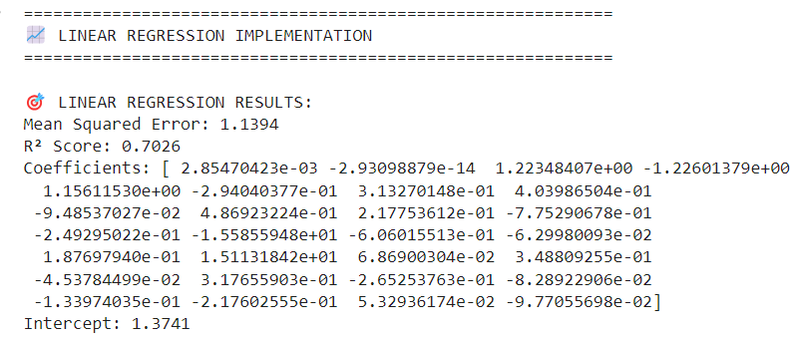
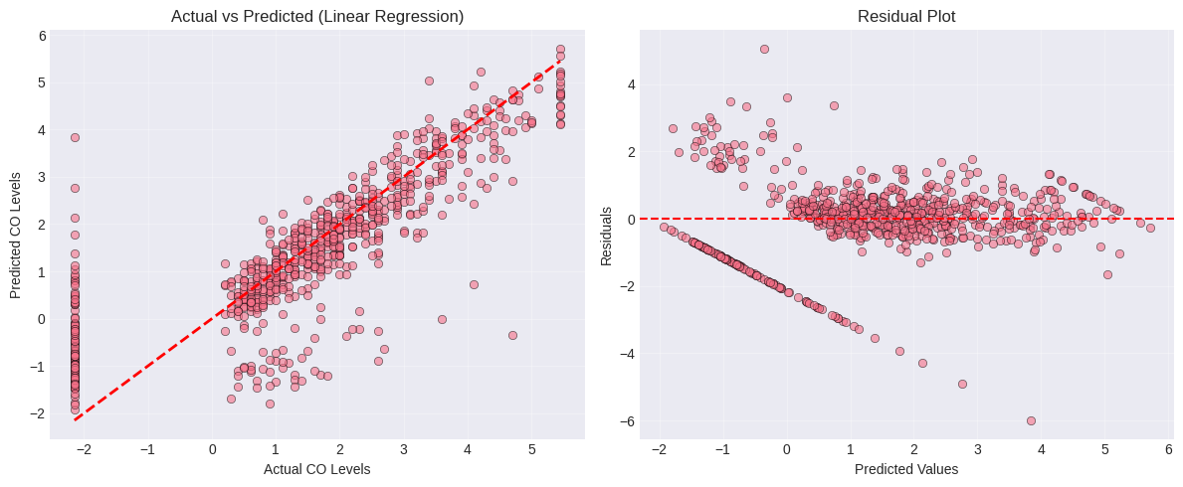

Linear Regression (Scikit-learn)
Objective:
Build a baseline regression model to predict CO(GT).
Evaluate how linear relationships explain air pollution.
What We Worked On:
Trained a Linear Regression model on cleaned, scaled data.
Used pollutant and temporal features as predictors.
Measured accuracy using MAE, RMSE, and R².
Served as baseline for comparing advanced models.

Slide 10
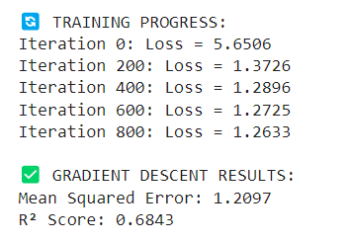
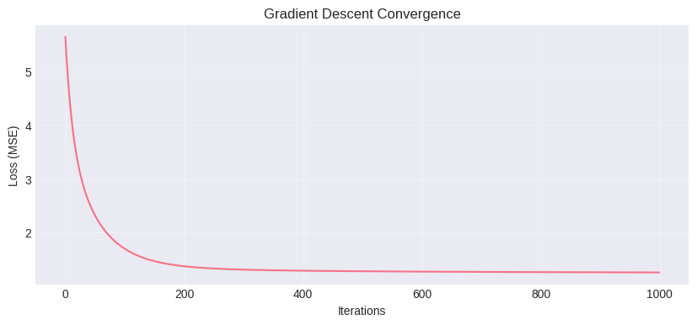



Linear Regression from Scratch (Gradient Descent)
Objective:
Understand how linear regression works internally using gradient descent.
Practice machine learning basics from scratch.
What We Worked On:
Implemented cost function & gradient descent manually.
Iterated over weights to minimize error.
Compared performance with Scikit-learn model.
Strengthened conceptual understanding of regression.

Slide 11
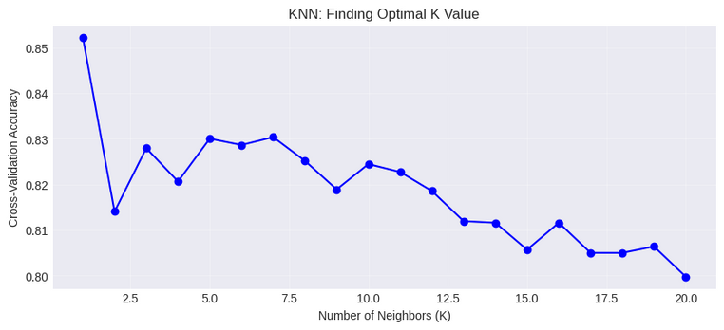
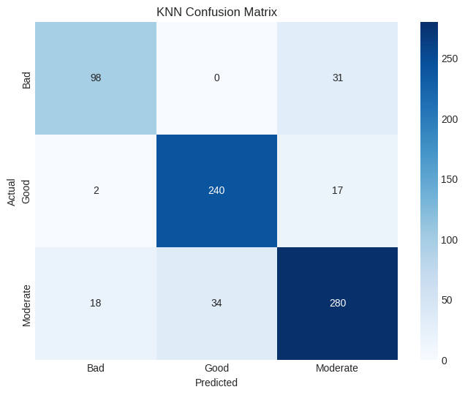
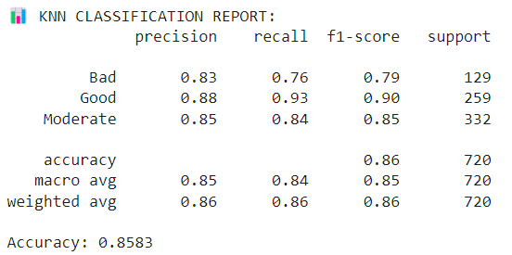
K-Nearest Neighbors (KNN) Classification
Objective:
What We Worked On:
Classify air quality into Good, Moderate, or Bad.
Evaluate a distance-based non-linear model.
Created classification labels based on CO(GT) levels.
Trained KNN classifier with different k values.
Evaluated accuracy, confusion matrix, and classification report.
Compared how well KNN captures local patterns in pollutant data.
KNN Confusion Matrix

Slide 12
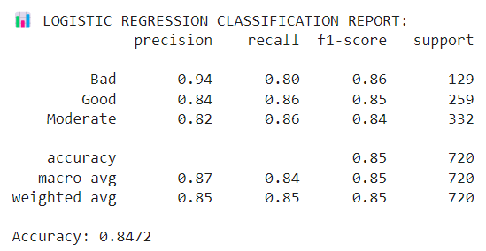
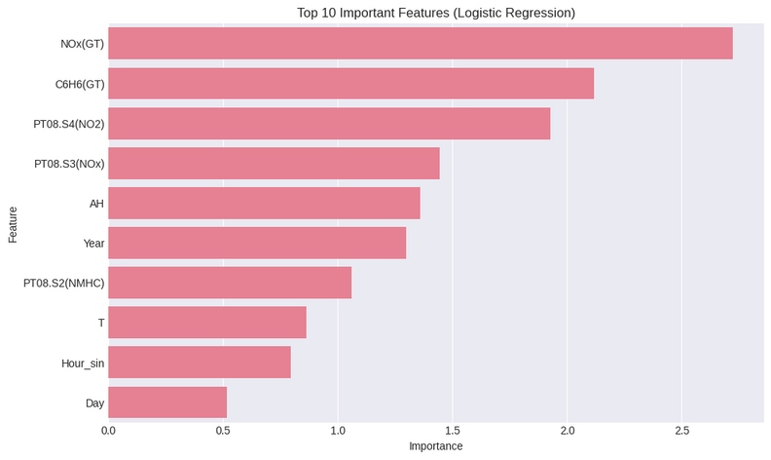
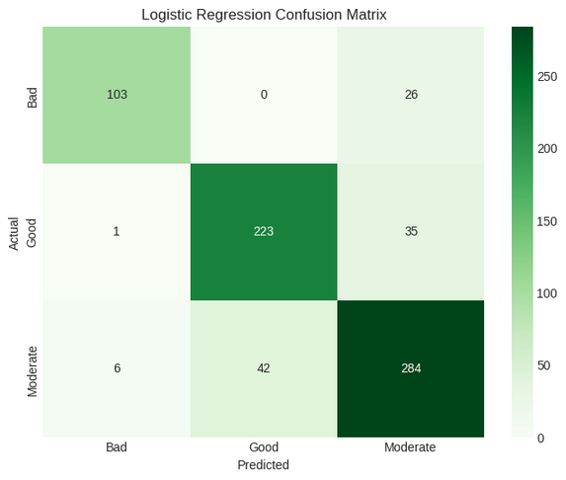

Logistic Regression Classification
Objective:
Apply a simple and interpretable classifier for pollution category prediction.
What We Worked On:
Trained logistic regression on categorical CO levels.
Checked performance using accuracy & F1 score.
Compared linear decision boundary vs. KNN’s non-linear boundary.
Learned how logistic regression interprets feature importance.

Slide 13

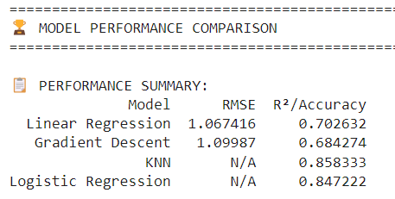
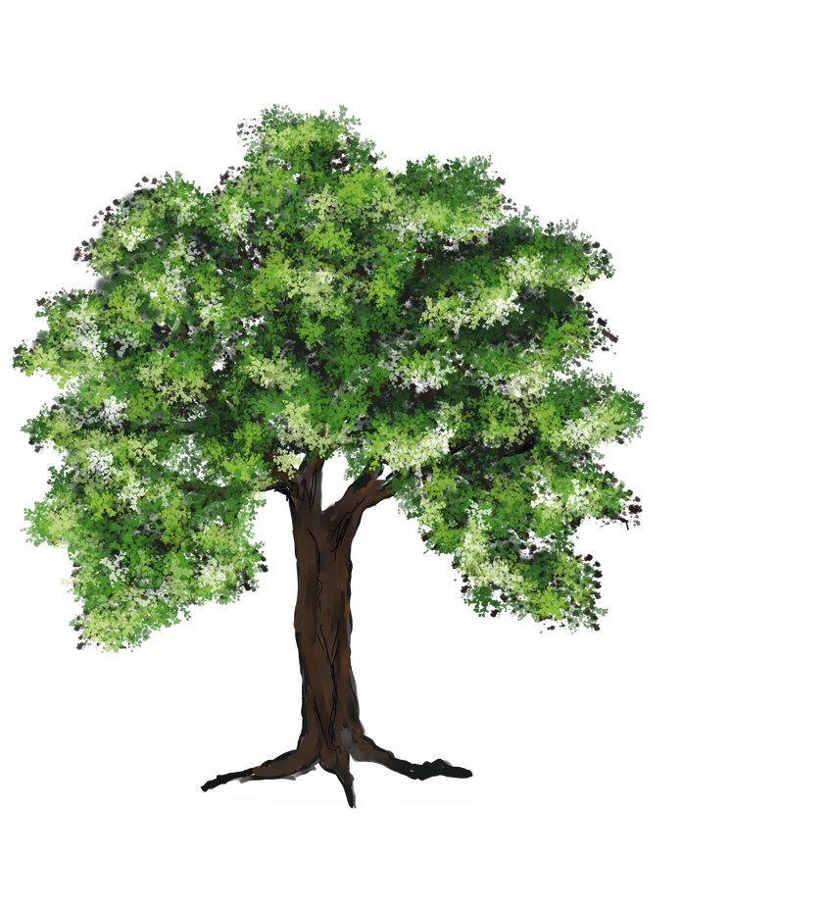
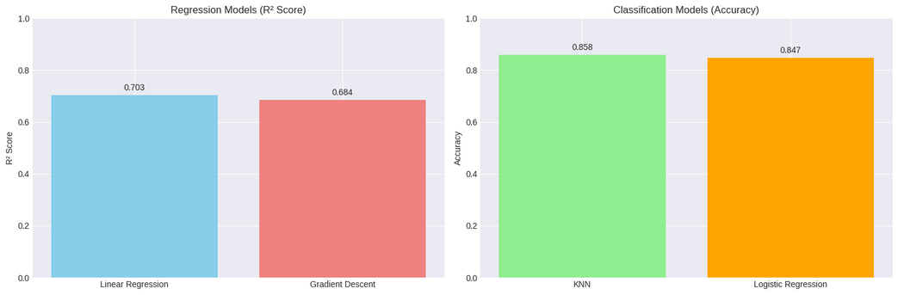
Model Comparison
Objective:
Compare all regression and classification models to select the best performers.
Measure and visualize performance differences.
What We Worked On:
Compared R², MAE, RMSE for regression models.
Compared accuracy, precision, recall for classification models.
Created performance graphs for clear visual comparison.
Identified which model predicts air quality best.

Slide 14
Thank You

